Slide 1


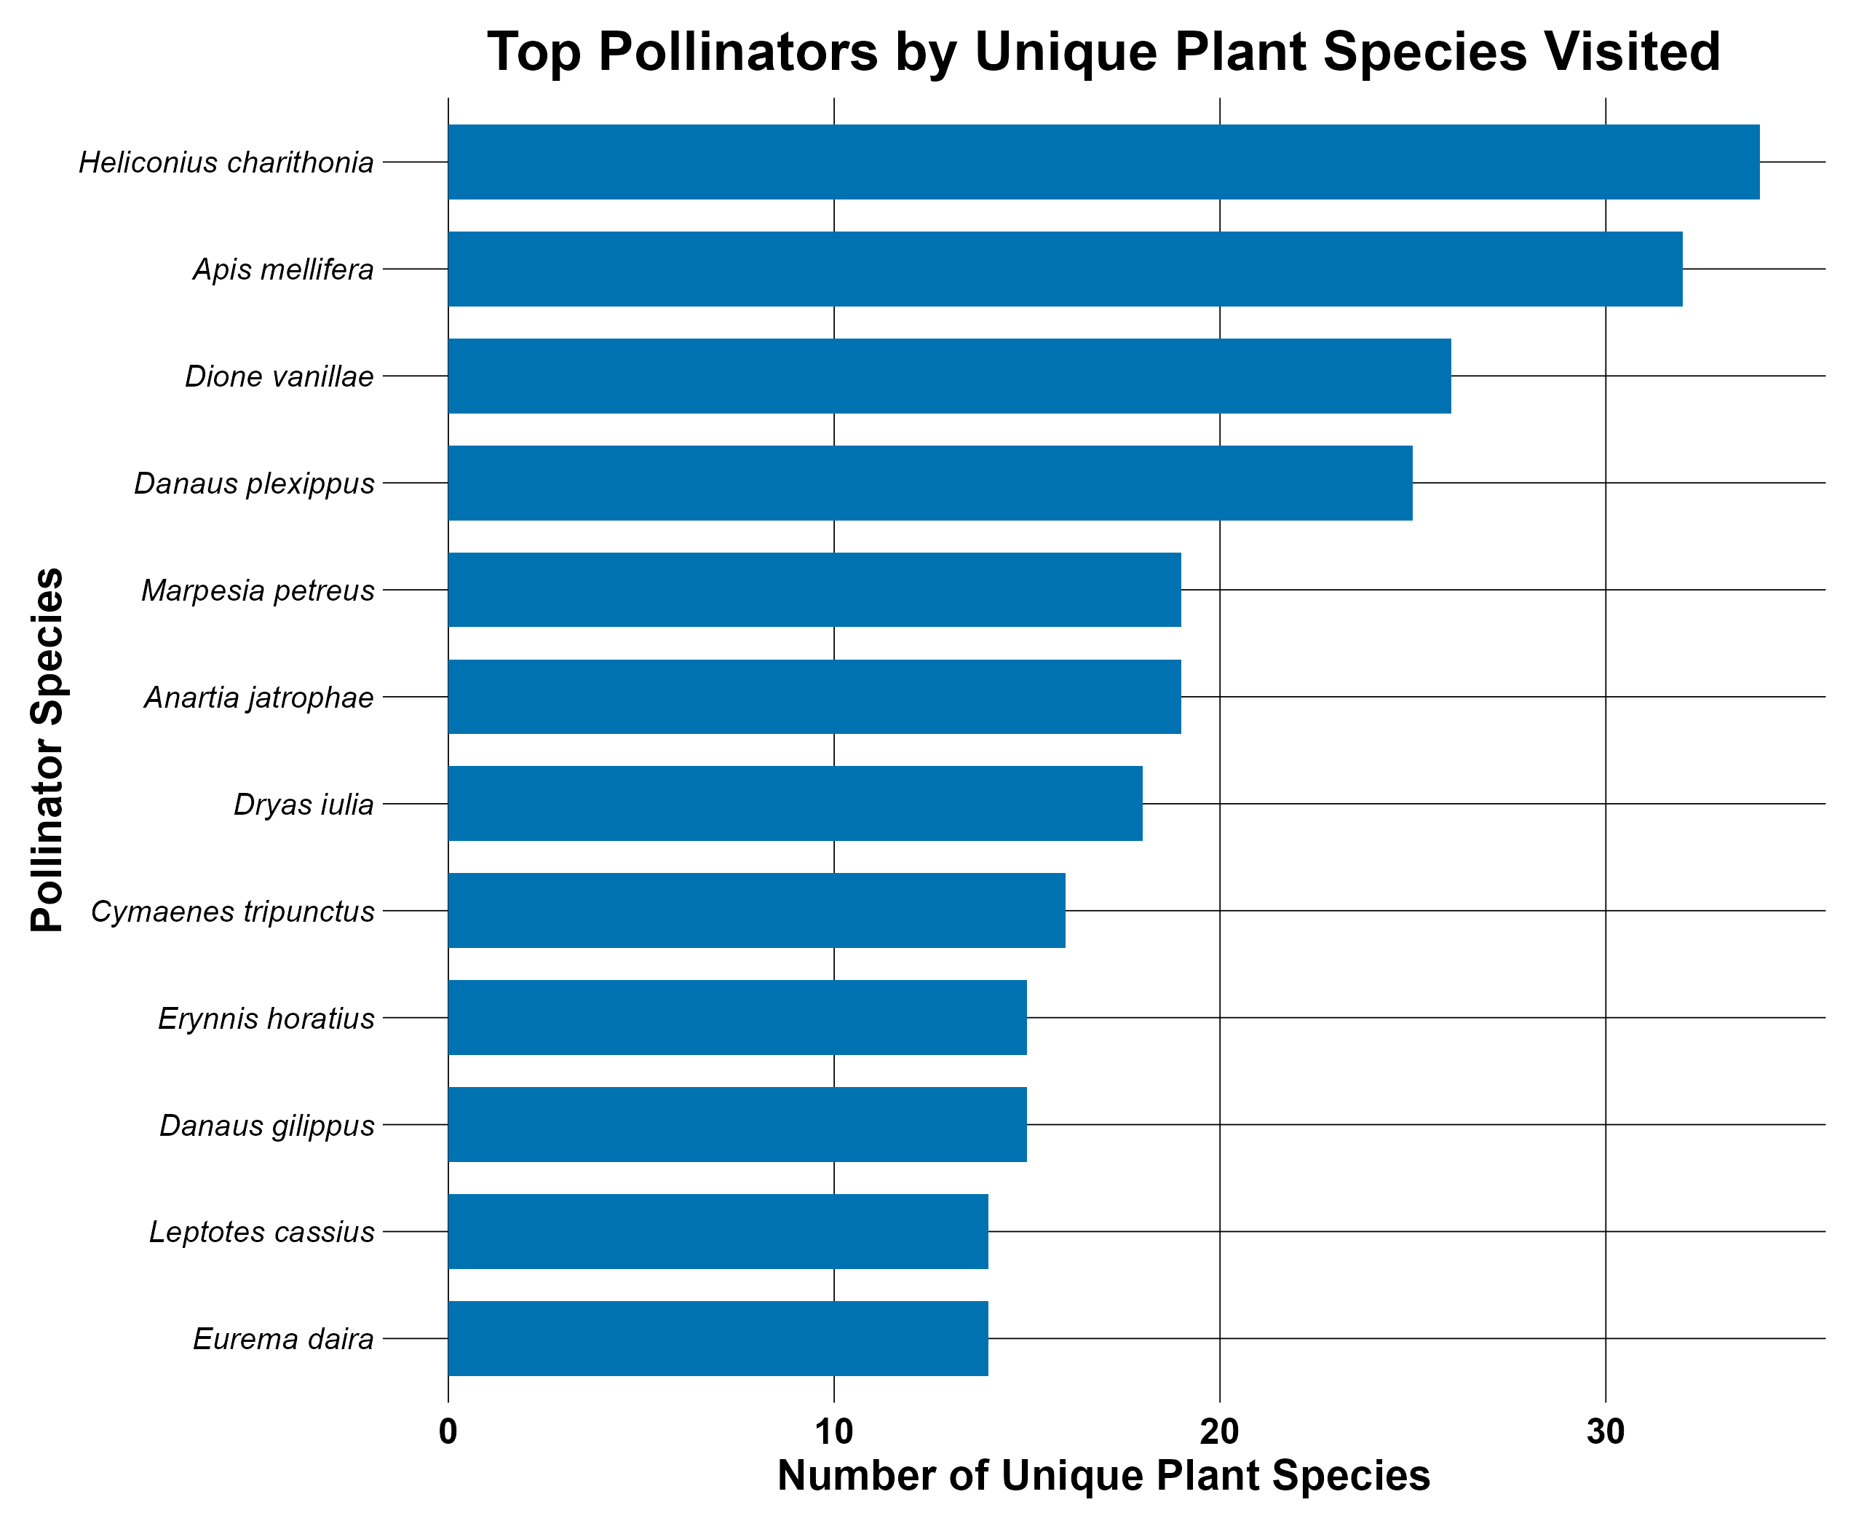
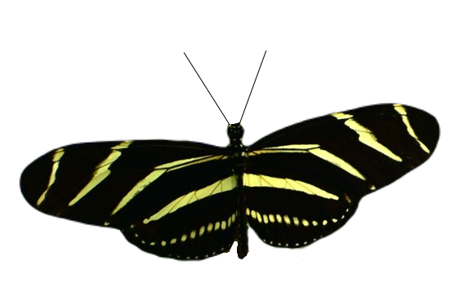
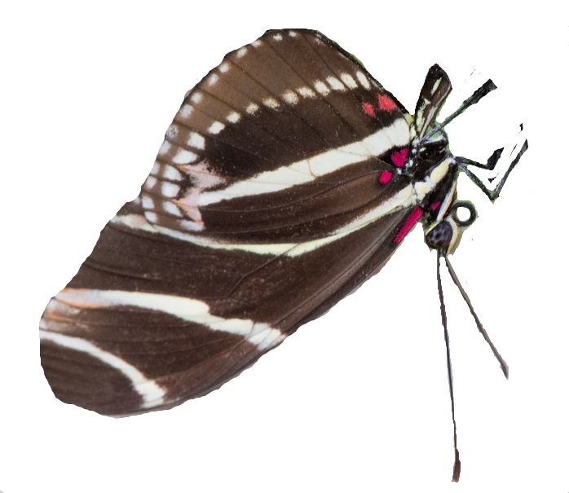
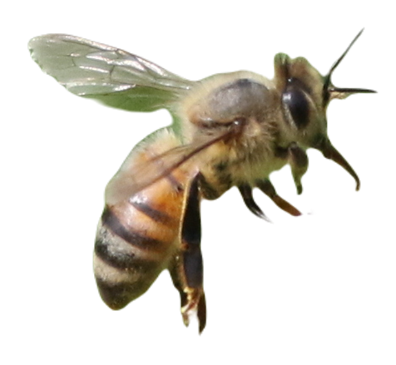
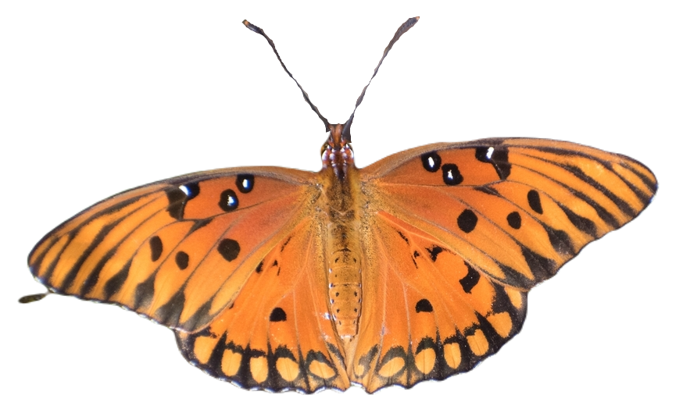
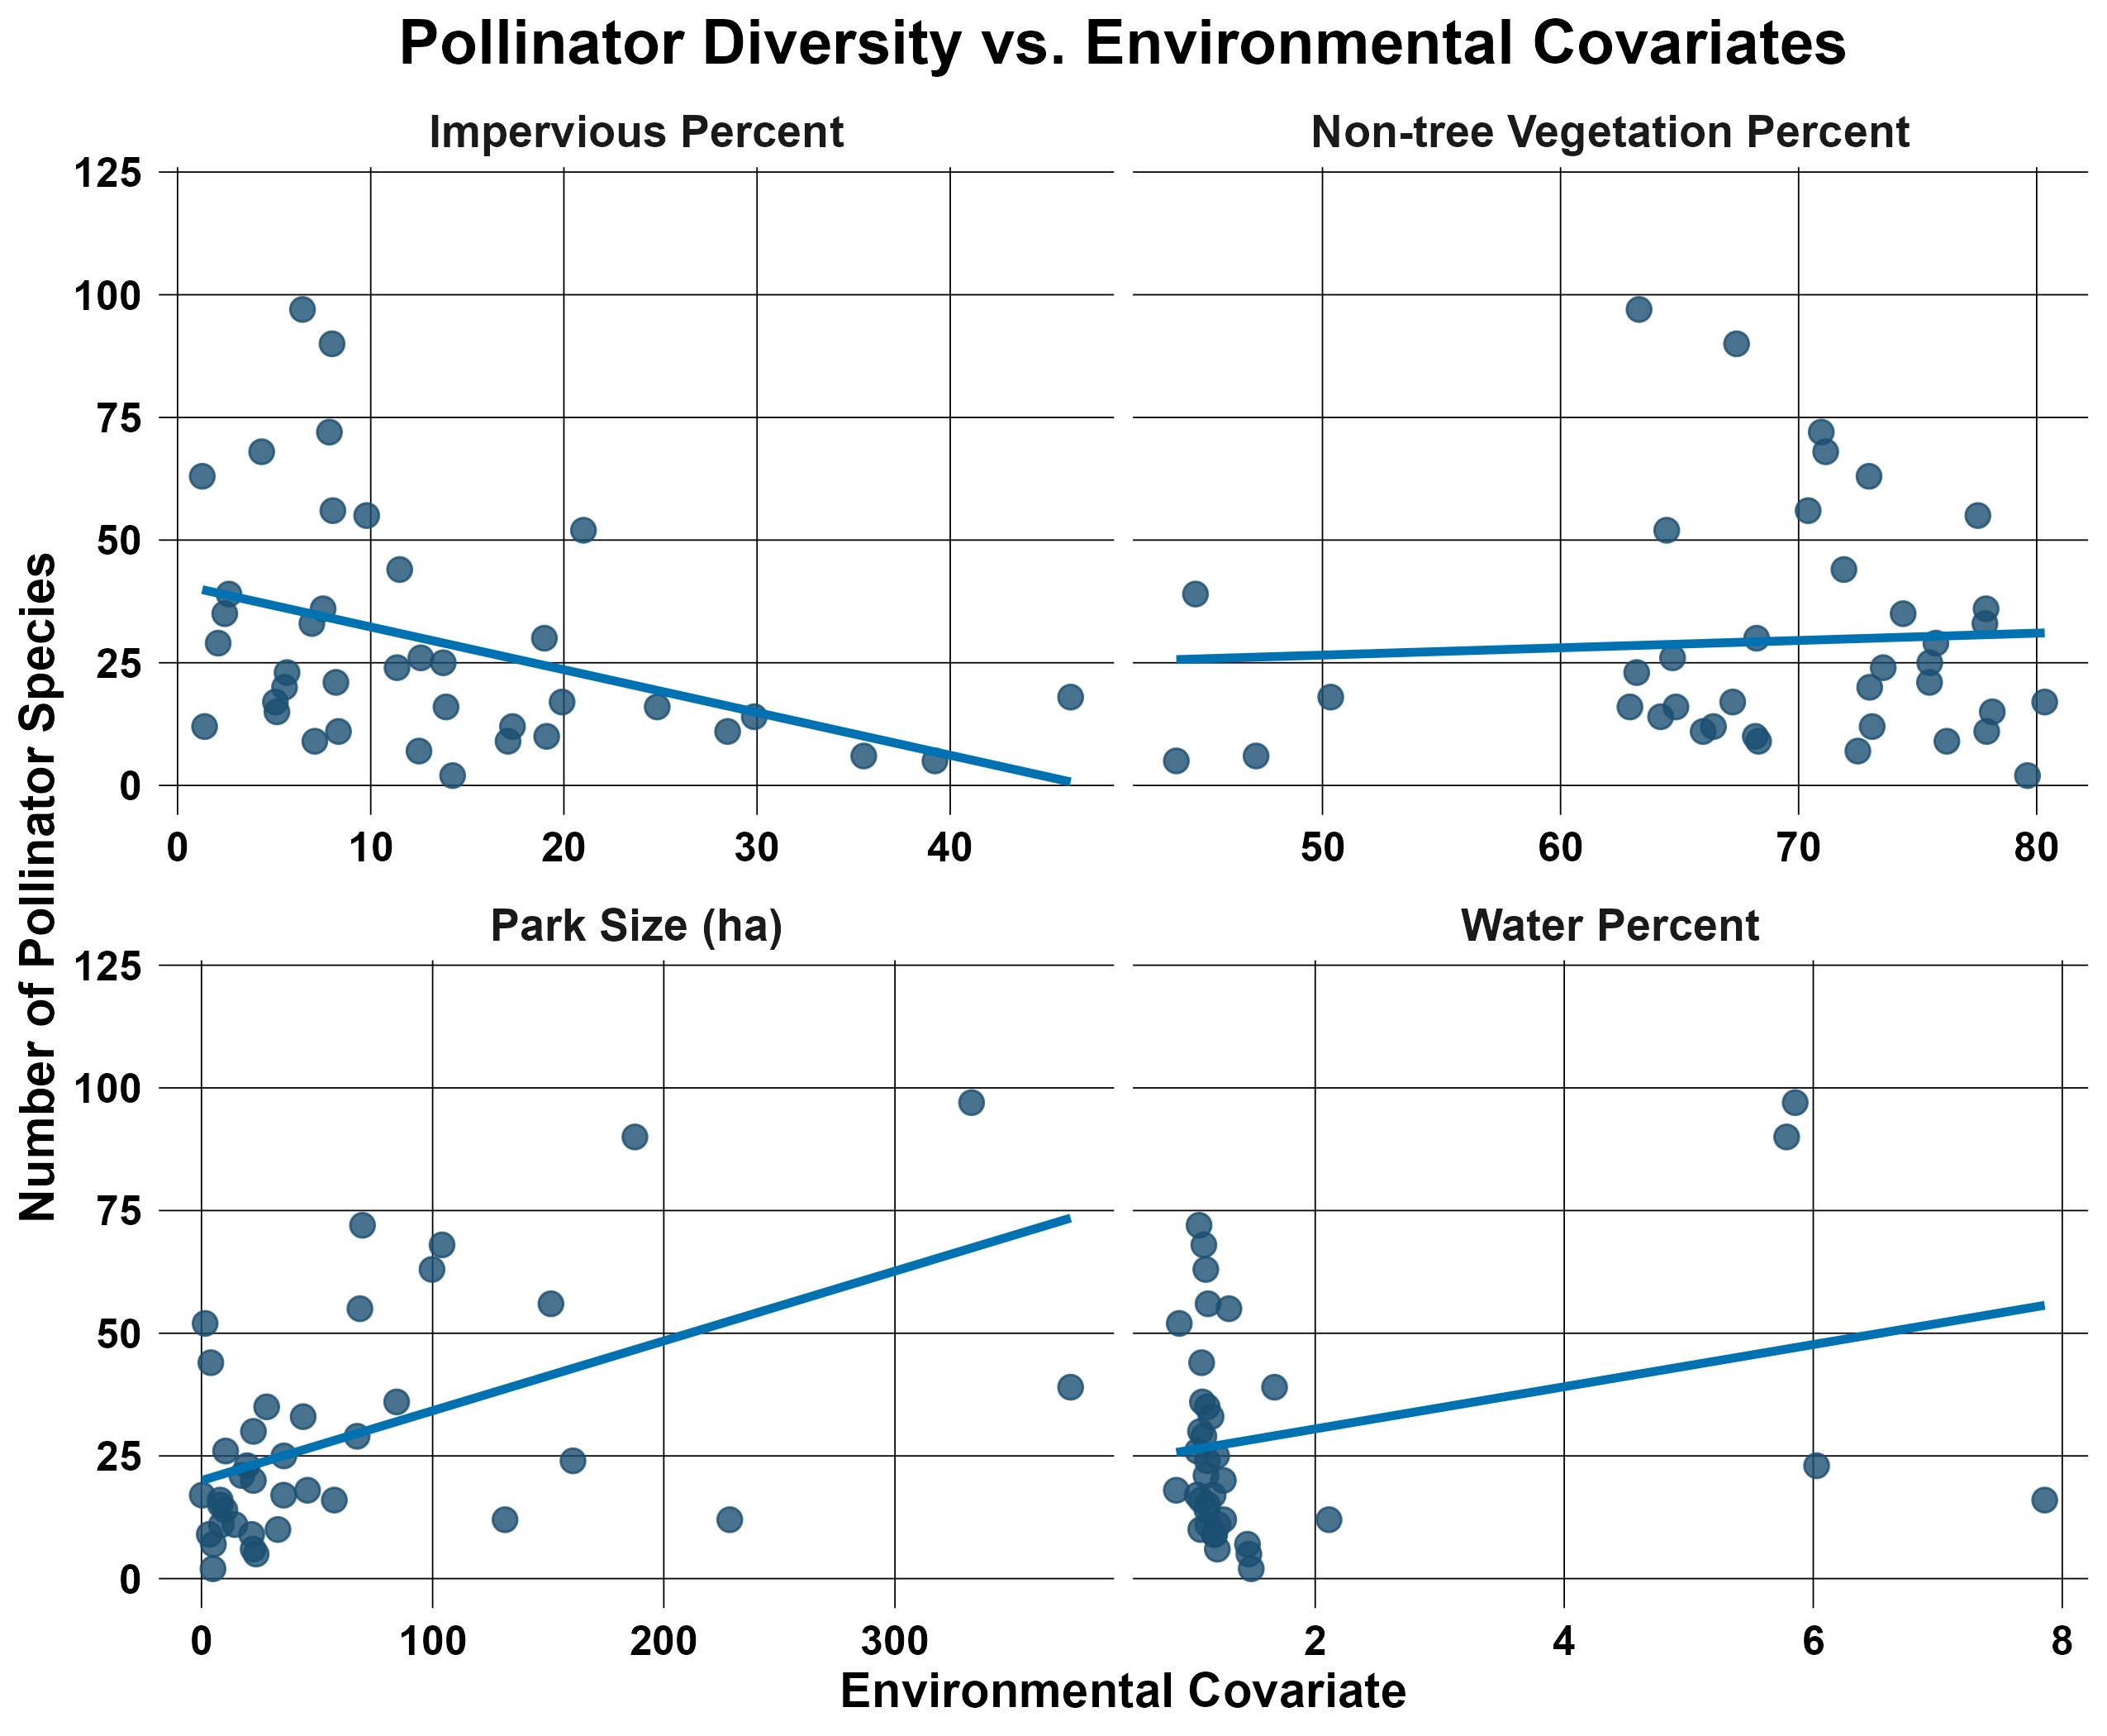
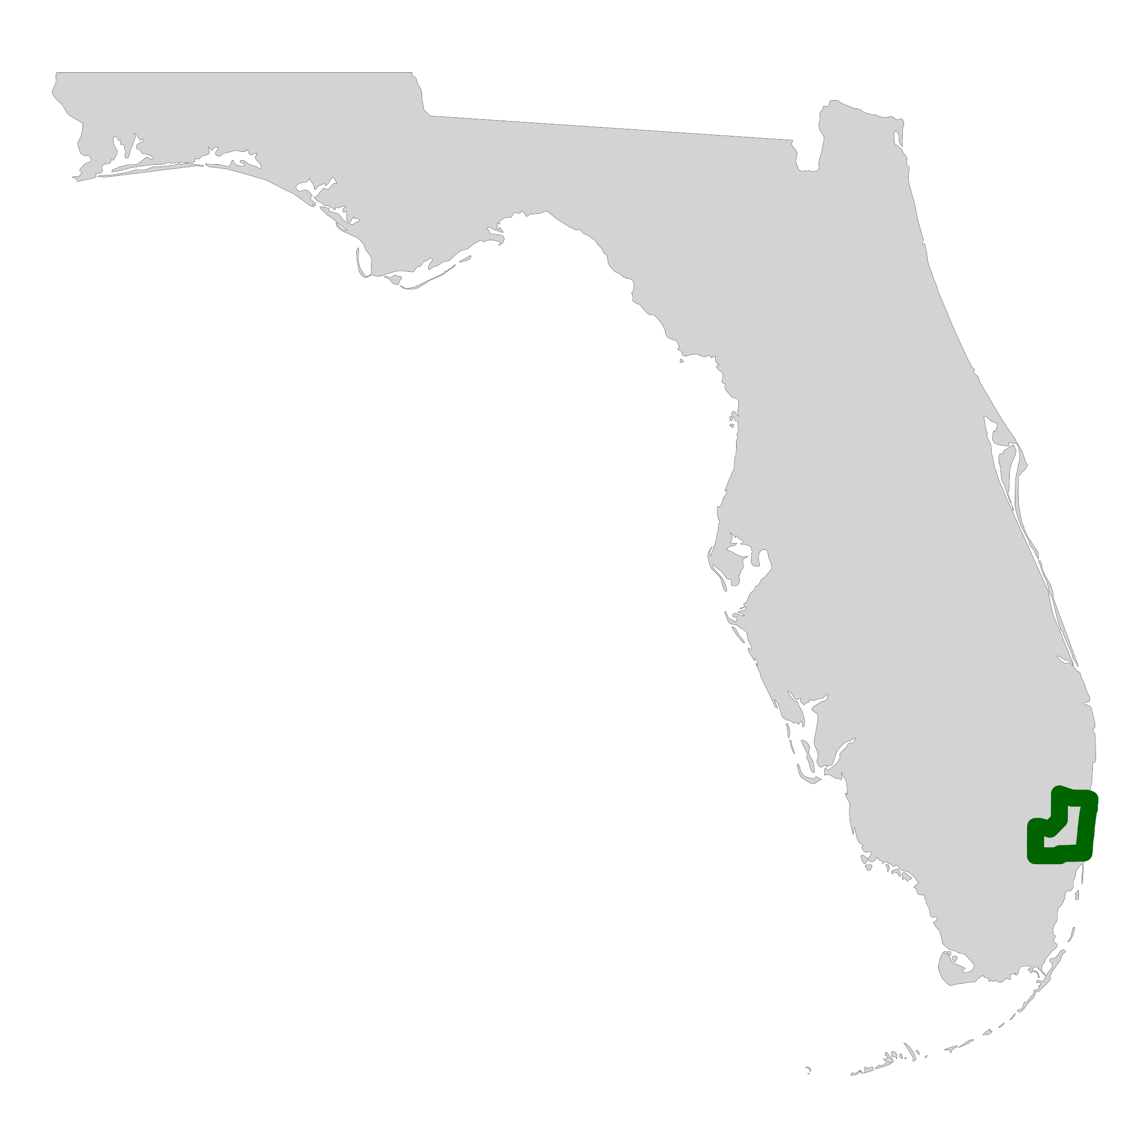
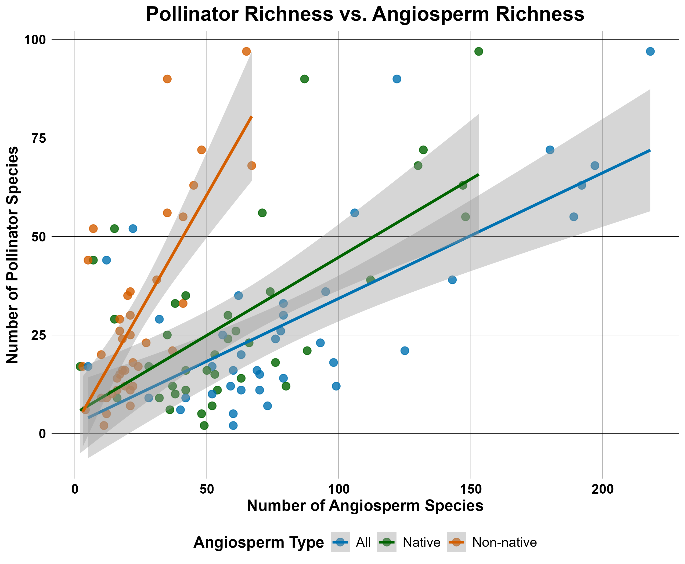


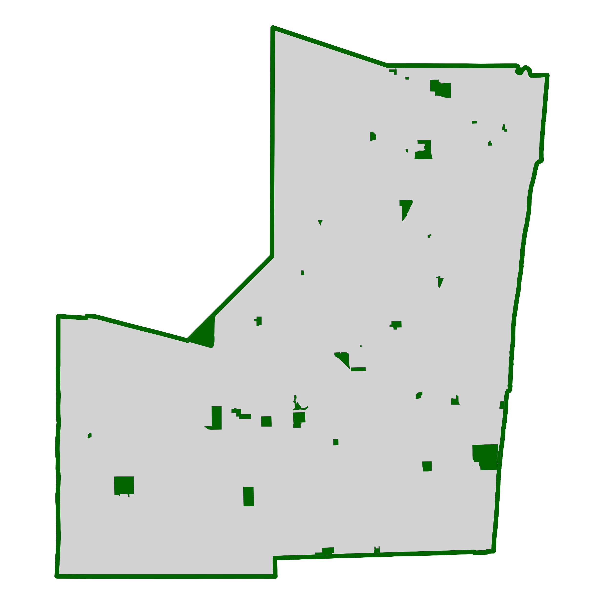



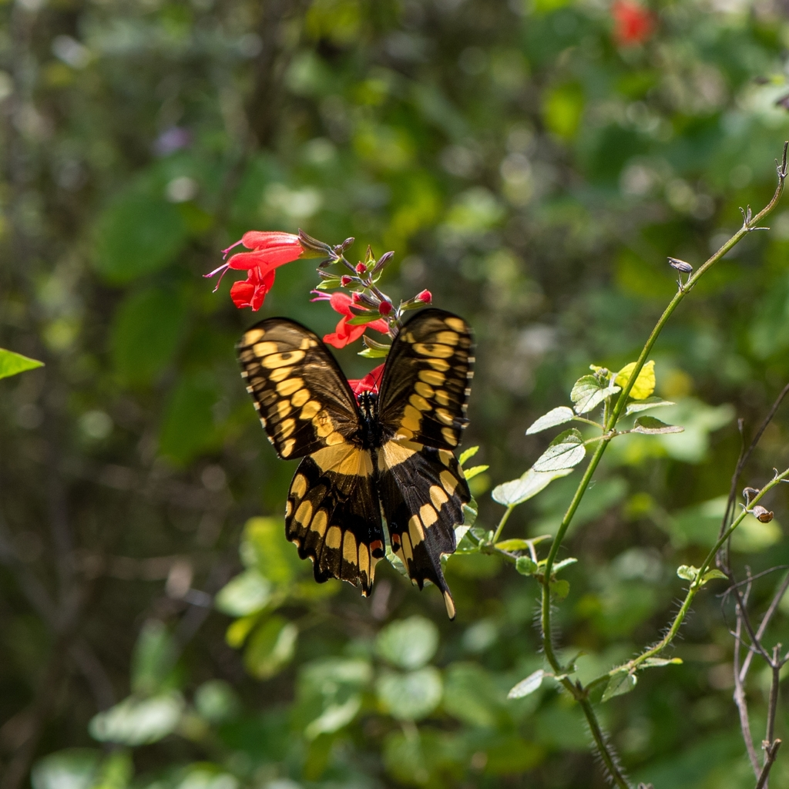
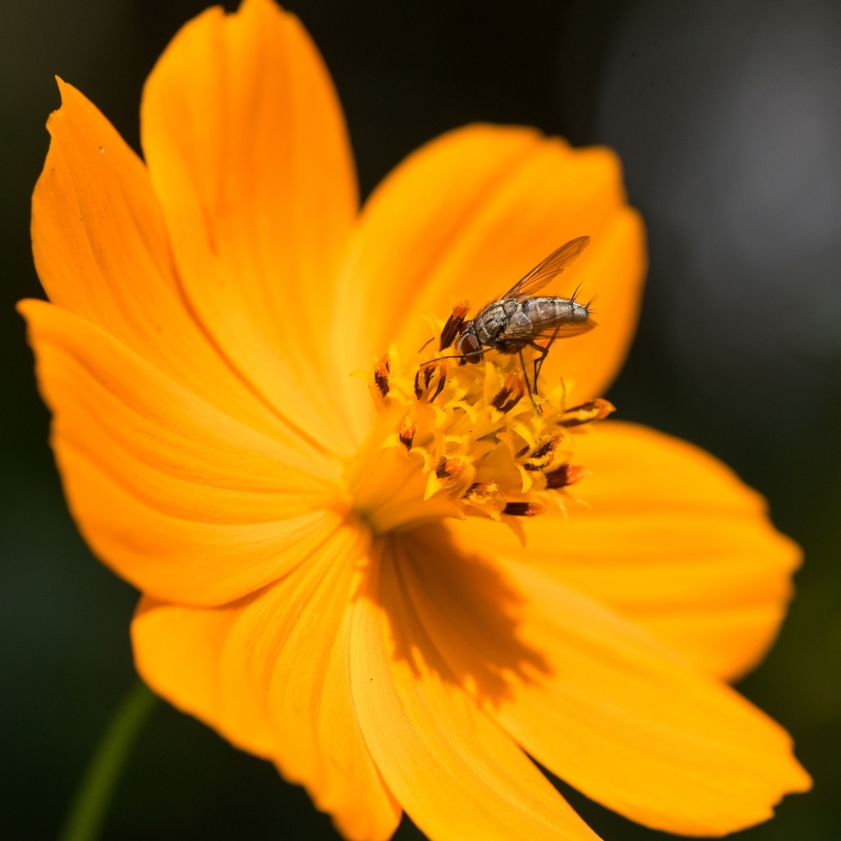
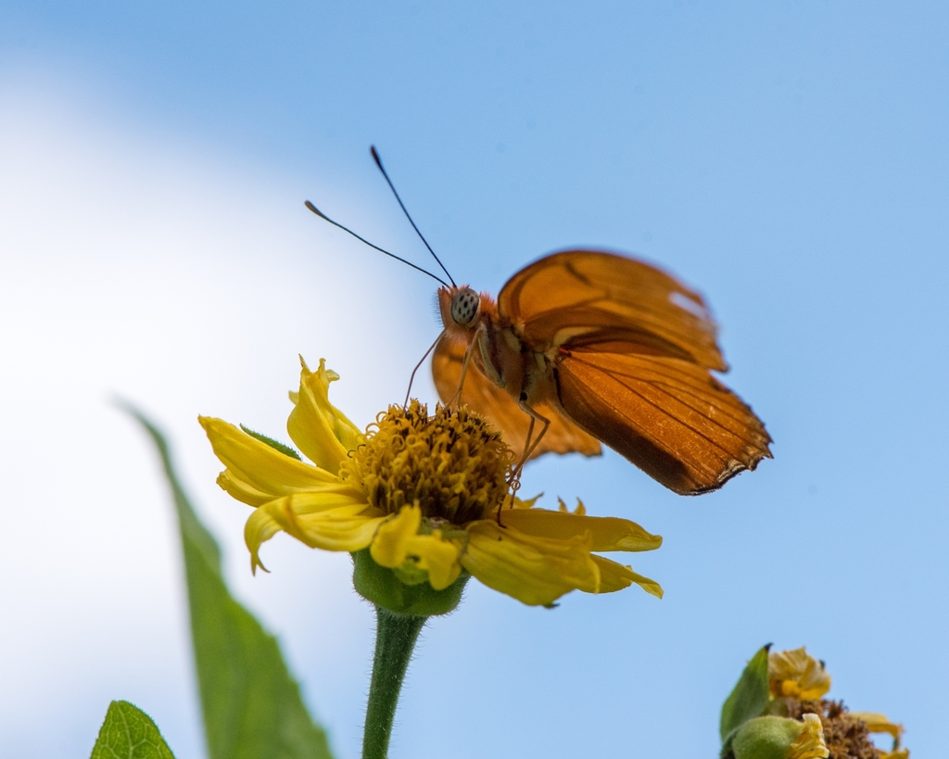
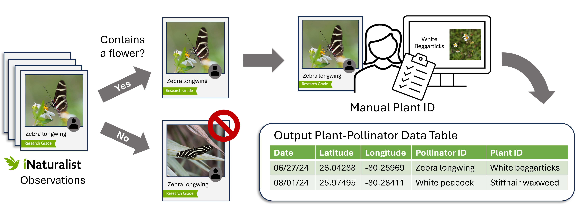
Drivers of pollinator diversity in urban greenspaces
T. Lilkendey¹, B.M. Mason¹, N. Pernat¹, J.S. Francis², C.T. Callaghan¹
¹Department of Wildlife Ecology and Conservation, Fort Lauderdale Research and Education Center, University of Florida, Davie FL 33314.
²Department of Biological Sciences, Florida Atlantic University, Davie FL 33314.
Introduction
Results
Urbanization is reshaping landscapes, with uncertain effects on pollinators in cities.
Understanding how greenspace attributes influence pollinator diversity can inform urban management strategies.
iNaturalist provides a large, accessible database of both pollinator and angiosperm observations that has the potential for more efficient data collection than traditional methods.
Objectives:
Understand how greenspace attributes, including the proportion of native and non-native angiosperms, influences pollinator and plant diversity in urban greenspaces
Quantify the number of pollinator species observed interacting with specific plant species
The pollinator species that visit the greatest variety of angiosperms are the Zebra Longwing Butterfly (Heliconius charithonia), the western honey bee (Apis mellifera), and the Gulf fritillary (Dione vanillae).
Flowering plant diversity, urban greenspace area, and the extent of water features and impervious surfaces predict pollinator diversity.
Pollinators may be adapting to non-native species diversity in urban greenspaces, highlighting the complexity of these novel ecosystems.
Methods
2,608 Images investigated
61% had a flower
1,435 total interactions
Figure 1. Top Pollinator Species by Unique Plants Visited Bar chart showing the number of unique plant species interacted with by each of the top pollinator species.
Downloaded iNaturalist data via GBIF from 39 urban greenspaces in Broward County, Florida
Downloaded raster data via Google Earth Engine on impervious cover, non-tree vegetation cover, and water cover, and calculated park size of each greenspace.​
Study area
Photos of plant-pollinator interactions from iNaturalist
Figure 2. Pollinator Richness vs. Angiosperm Richness Scatterplot comparing pollinator species richness with richness of native, non-native, and total angiosperm species across parks. Each point represents a park.
Figure 3. Pollinator vs. Environmental Covariates Scatterplots show the relationship between the number of pollinator species observed in each park and environmental covariates including impervious cover, non-tree vegetation cover, park size, and water cover.
Greenspaces in Broward County
Management Implications
Discussion
To increase pollinator diversity:
Common plant species can support a wide variety of pollinators.
Minimize impervious cover and increase water features and park area.
Park managers can use iNaturalist and similar platforms to monitor pollinator–plant interactions, inform adaptive management, and foster community engagement in conservation.
iNaturalist images provide reliable data on plant-pollinator interactions, allowing us to document the pollinator species that visit the greatest variety of angiosperm.
Our results highlight the utility of citizen science data in understanding the effects of urbanization on pollinator communities.
More work in the future can allow for continued use of iNaturalist data in other settings.
Workflow to extract data

